Slide 1
Data Quality
Setting the stage for the DHIS2 Data Quality Academy

Slide 2
Overview
For these themes, we will discuss in plenary
Definitions
Implications
Causes
Strategies

Slide 3
Why is it important address data quality?

Slide 4
Data use drives data quality
Virtuous Data Cycle
Poor
Good
Data Quality
Data driven actions/decisions
Ownership of data and data culture
Demand for data at all levels
Low
High
Data Use
When feedback loops are established, Interventions exhibit higher uptake and better traction.
Notes:
Here we introduce the virtuous data cycle: a driving component of a health information systems. We have data quality at the top and data use at the bottom.
If we have high data use we have high data quality, but
if we have low data quality we will have low data use.
These two thing data use and data quality are completely dependent on each other. Data quality can not be addressed in data quality assessment entirely. You have to be on the constant quest to improve data quality at all times and we are going to teach you how to do that.
The key drivers of increased use and quality are the basis of the rest of the course
data driven decisions, at each of the three levels identified
ownership of the data at all levels so that stakeholders take a pride in the quality of their data
a data culture, whereby quality data is valued
demand for data at all levels because everyone trusts the data and is using it

Slide 5
Why do you think HMIS data is often poor quality?
Poor form design, poor system design, high reporting burden. → The people who made the system do not use it.
People do not feel accountable for data → They are receiving any feedback or notifications that the data is being checked.
People (CHWs, facility staff, district staff) do not feel ownership for data → They are not using it and they do not see proof that it is being used.
Data is not trusted → People assume it is bad because they do not understand how the data is captured and what management controls are exercised.
They do not see any indication of data quality issues.
They can not see the problems because there is no transparency into the data quality issues.

Slide 6
How do you define good data quality?
Data is of high quality when it is fit for its intended uses (operations, decision making, planning)
What makes it ”fit”?

Slide 7
Data Quality Dimensions
Completeness
Expected comprehensiveness. ”Enough to make (good) decision”
Somewhat measurable in DHIS2
Timeliness
Available when it is expected and needed
Somewhat measurable in DHIS2

Slide 8
Data Quality Dimensions
Consistency
Data across all systems reflects the same information and are in synch
Conformity
Data is following a set of standard definitions
”Malaria” vs. ”Confirmed Malaria”?
Accuracy
The degree to which data correctly reflects the real-world event
Integrity
Internal consistency of your data. Traceability
In tracker; are patients not found and registered several times? Leads to duplication

Slide 9
Some examples from the real world

Slide 10
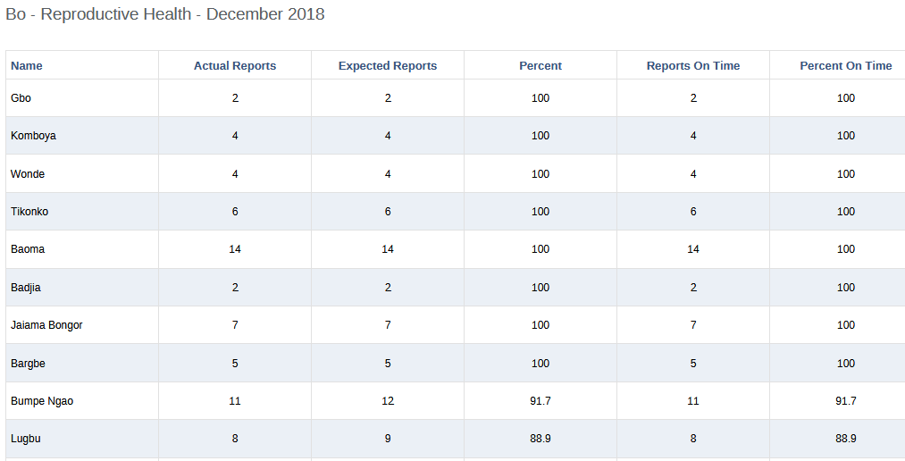
Completeness

Slide 11
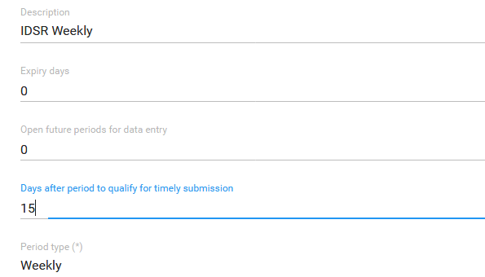
Timeliness

Slide 12
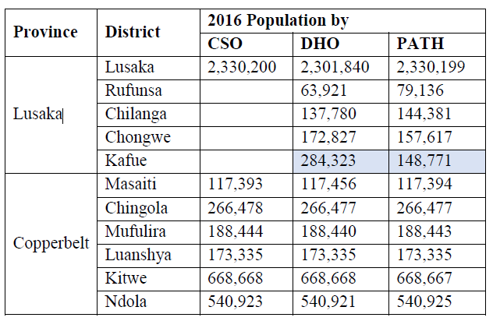
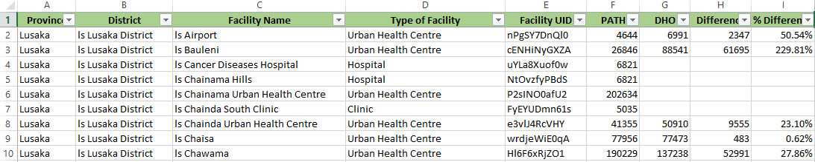
Consistency

Slide 13
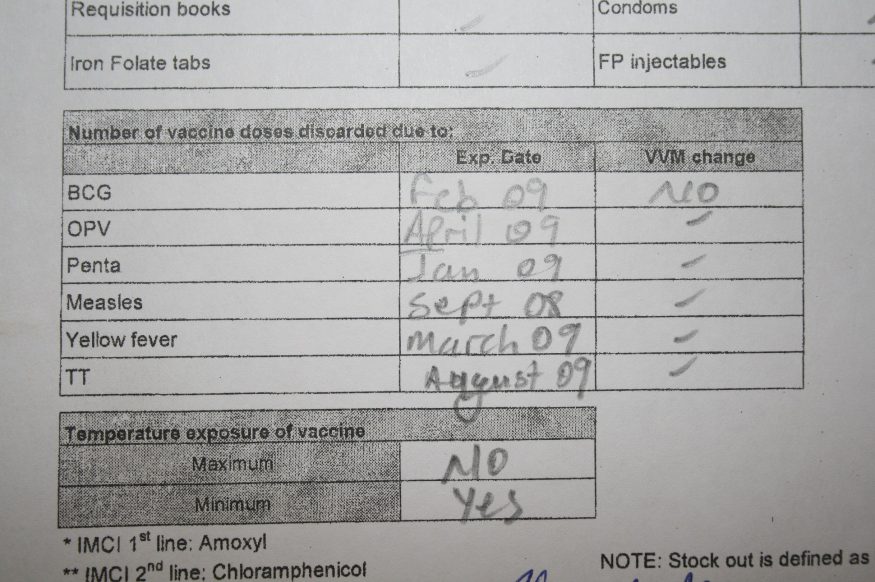
Conformity

Slide 14
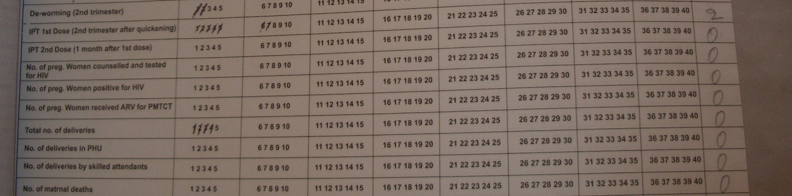
Accuracy

Slide 15
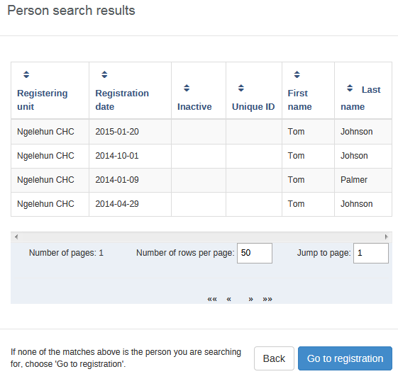
Integrity

Slide 16
Data Quality Issues are a fact of life.
Every database, country, program has data quality issues.
Every information system will have:
Outliers
Data entry errors
Validation alerts
Fradulent data (made-up date)
Data quality issues are a feature of any information system, not a failure
The failure is not being able to address the data quality issues.

Slide 17

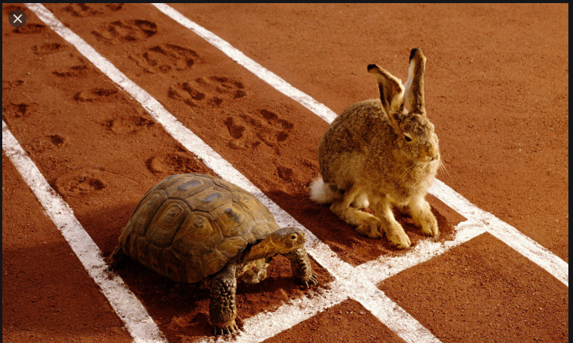
It is not a race. It’s a process.
DQ Issues
DQ Corrections

Slide 18
Strategies to handle data quality issues
What this academy is about!
1. Before
Design. Training. Relevance. Resources
2. During
Adequate time. Feedback. SOPs. Checks. Less manual aggregation
3. After
Data Quality Assessment. Data cleaning.
Also cyclic: go back to step 1 after data cleaning

Slide 19
A vicious cycle
Donors get
their own
Decisions not evidence-based
Data not trusted
Weak demand
Using evidence not perceived as a winning strategy
Poor data
quality
Limited investment
in HIS
Fragmentation
Weak HIS
limited capacity
to manage or analyse data
Notes:
19
These problems (fragmentation, limited skills and motivation, burdensome data management) have created a vicious circle: incompleteness and poor quality of data have prevented access to useful information which in turn has undermined the motivation at all levels for strengthening the routine health information system.

Slide 20
Assignment: List 5 reasons why you have data quality issues in your country/project?
Examples:
Wrong use of data. Maternal mortaliy ratio at facility?
Lack of SOPs
Manual aggregation
Little or no use. No feedback

Slide 21
Assignment: List 5 implications of poor data quality in your country?
Examples
Wrong (or no) decisions
Trust and use, weak accountability
A vicious cycle

